Slide 1






Welcome to Reception at Carleton Green

Slide 2
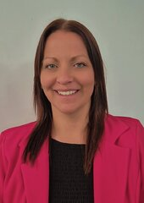
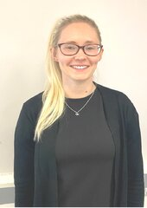
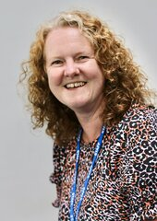
Our school team
Mrs S Clark - Headteacher, DSL and SENDCO
Miss R Savage - Business Manager
Mrs A Catterall - EYFS Lead

Slide 3
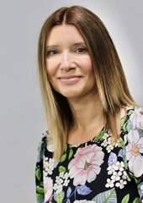
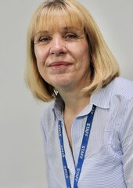
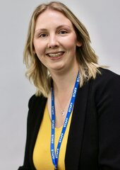
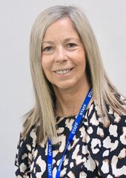
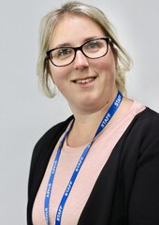
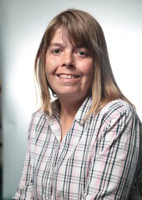
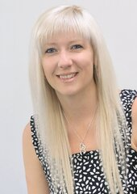
Our EYFS team
Mrs A Catterall - Yellow Ducklings Class Teacher
Miss S Lees- Brown Ducklings Class Teacher
Mrs J Stock - HLTA
Mrs L Richardson - LSA
Miss J Watmough - LSA
Mrs Z Strickland - LSA
Miss L wilson - LSA
Mrs A Kelly - Bodell - LSA

Slide 4









The Carleton Code
At Carleton Green we aim for our children to be:
•
•Confident in their own ability
•Achieve their full potential
•Responsible and Reliable
•Life-long Learners
•Energetic and healthy
•Trustworthy
•Organised
•Nurturing

Slide 5
Our House Teams
At Carleton Green, we have four house teams.
Athena
Demeter
Poseidon
Apollo
All children wear the matching tie and PE t-shirt for their team. The children compete in different events in their House teams, including Sports Day.
You can find out which house team your child is in by looking at the sticker on your welcome pack envelope.

Slide 6
Our School Day
8.55 am | Meet & Greet
9.00 am | Register and Morning Maths
9.15am - 9.30am | Phonics
9.30am - 11.00am | Learning through play in the Continuous Provision and adult-led group time
11.00am - 11.20am | Topic Time
11.30am - 12.30pm | Lunch time
12.30pm - 12.45pm | Mathematics
12.45pm - 3.00pm | Learning through play in the Continuous Provision and adult-led group time
3.00pm - 3.30pm | Reflection time/ Assembly/Story /Home time

Slide 7
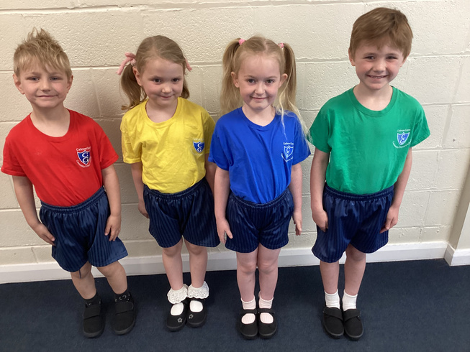
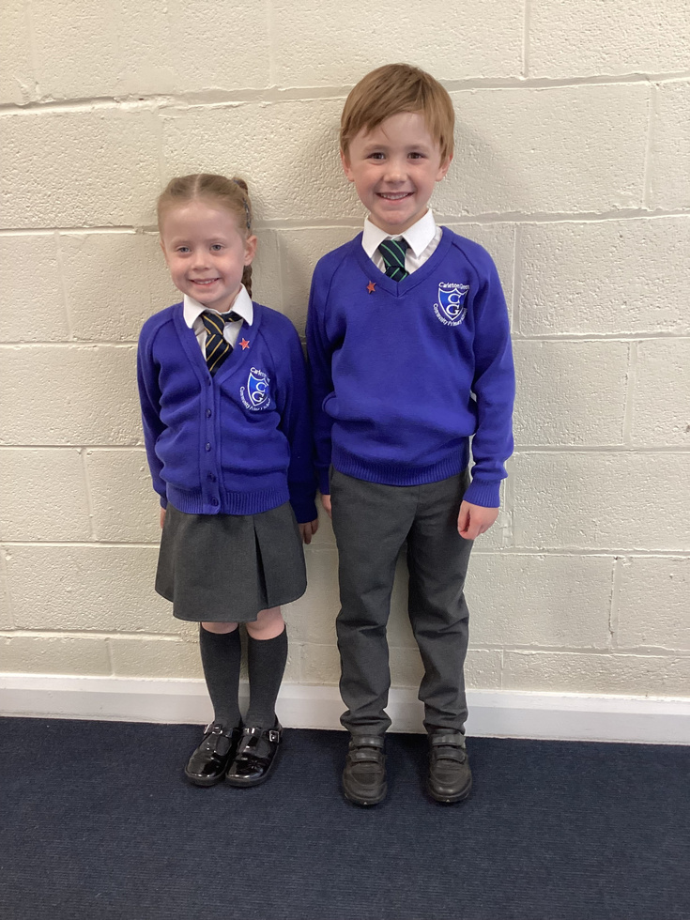
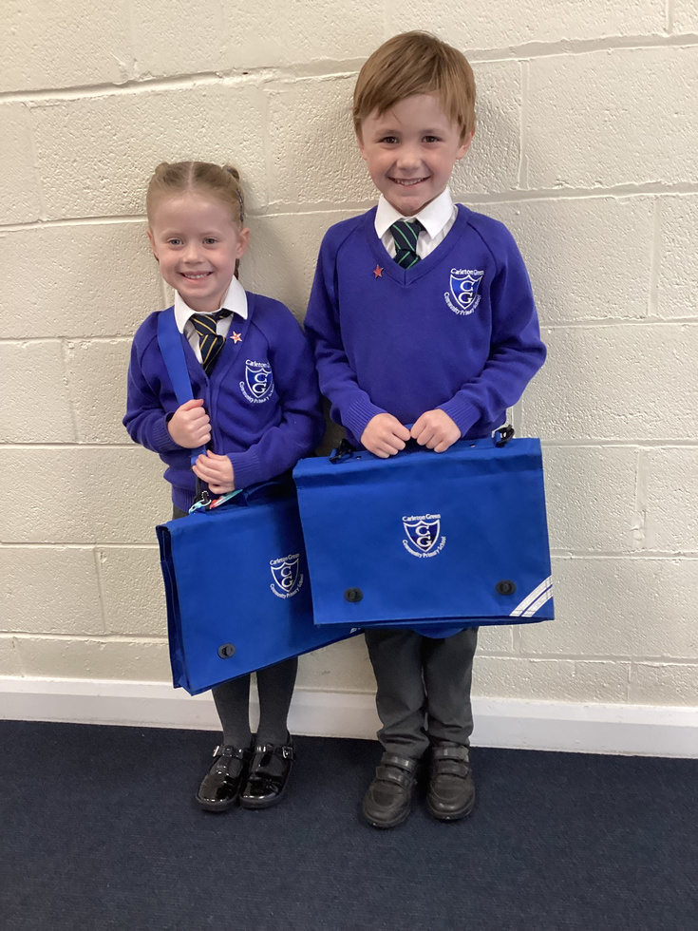
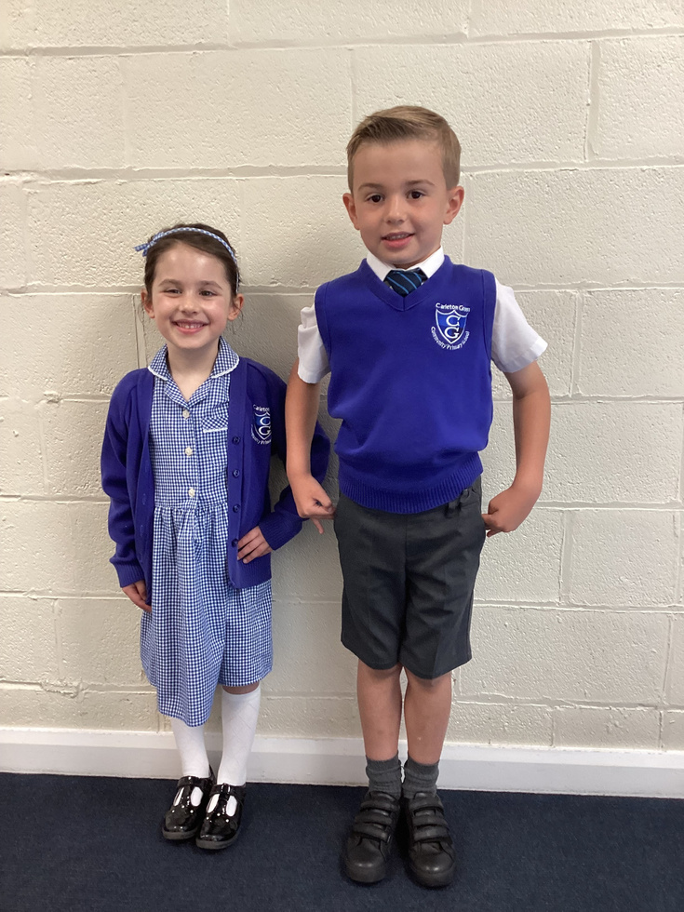
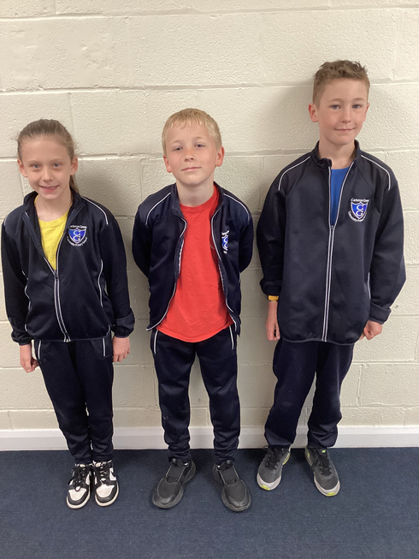
Our PE Kit
Uniform
Our Winter uniform
Our Summer uniform
Our PE tracksuit
Our school uniform can be purchased from Bispham Clothing.

Slide 8



Our School Meals
Lunch time
Healthy School
Milk
All Reception and KS1 children are entitled to a free school meal. There is no requirement to fill in any paper work as this is an automatic requirement.
Our school is participating in a Government scheme where all children aged 4 - 6 are entitled to receive a free piece of fruit each school day.
School milk is free for all children under the age of 5.
All children need to be registered through the Cool Milk website.
Our school has a strict ‘no nuts policy.’
Your paragraph text

Slide 9
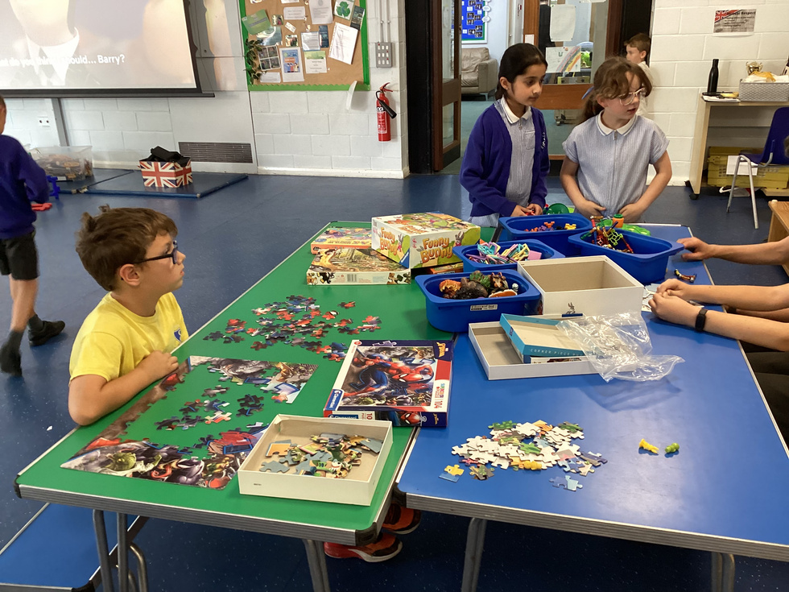
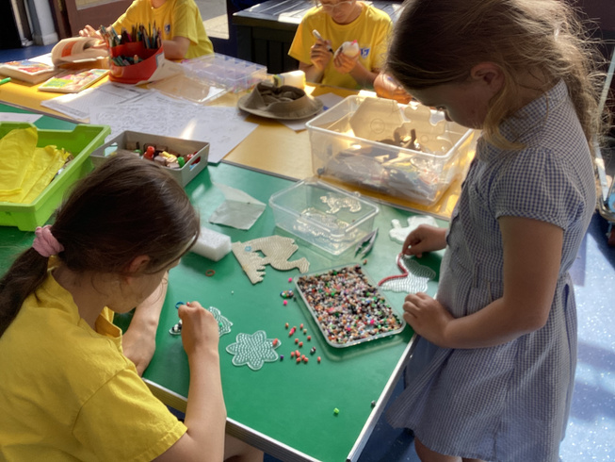
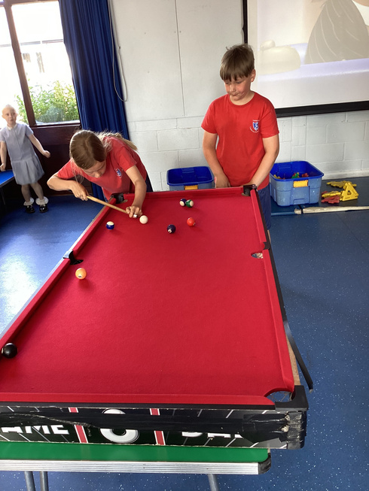
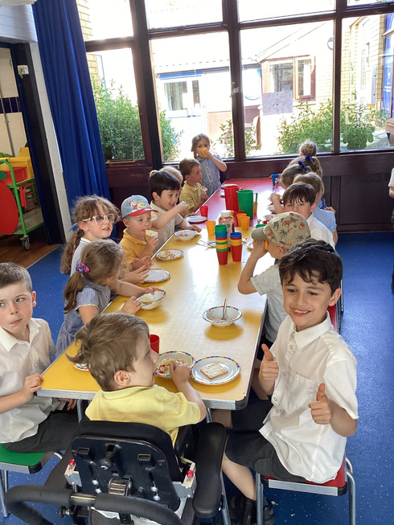
Breakfast and After School Club
Early Bird Breakfast Club
7.30am - 8.55am
Fee: £4.50 per session
Breakfast included
Late Larks After School Club
3.30pm - 5.30pm
Fee: £7.50 per session
Afternoon snack included

Slide 10
Pupil Premium
Pupil Premium is additional funding for publicly funded schools in England. Pupil premium is funding to improve education outcomes for disadvantaged pupils and also provides support for children and young people of service families.
This funding provides support for trips, uniform, Breakfast and After School Club and school meals.
Please complete the eligibility form in your pack.

Slide 11
Your Welcome Pack
Please spend some time reading through all of the information in your welcome pack. As well as the paper pack, you will receive an email with additional electronic forms from the school office.
You will find all of our important consent forms needed to enrol at school and lots of information about starting school and being ‘school ready’.
We kindly ask for all forms to be returned to school by
Friday 20th June 2025.
Completing the Nursery Visit Form and the Data Collection Form this evening would be most helpful.

Slide 12
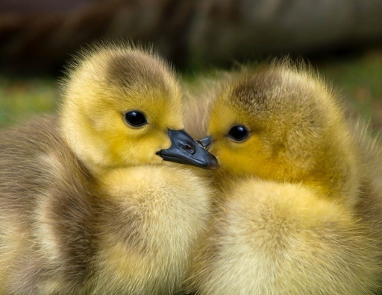

Starting in September
Once the EYFS team have had the chance to get to know your child, they will be assigned to either Yellow or Brown Ducklings class. You will find out which class and teacher they will have after the stay and play morning on Thursday 3rd July 2025.
At Carleton Green, we use Class Dojo to connect you to your child’s school experience. We share photos, videos and announcements on a regular basis. In September, please look out for a special QR code to help you link to your child’s class.
Our First Day - Tuesday 2nd September 2025 at 8.55am

Slide 13
Thank you for choosing Carleton Green!

Slide 14
Any Questions?

