Slide 1






Being Ready for School

Slide 2
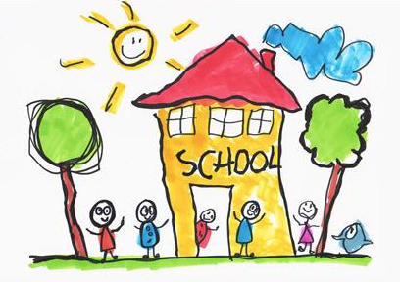
How can I get my child ready for school?
We know that as parents you want to do the best for your children and give them the best start to school as possible. We understand that each child is at a different stage of their development starting school and that each child will have individual needs.
If you have individual questions please talk to your child’s pre-school, who will also be helping the children to move into school by supporting growing independence.
If you have any concerns about your child’s hearing or vision you could contact your health visitor, optician or GP.

Slide 3


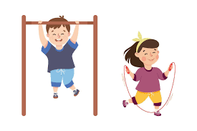
Prime Areas
The 3 prime areas are:
  Personal, Social and Emotional Development
  Communication and Language
  Physical Development
These prime areas underpin the specific areas of learning and are a focus when children start school.

Slide 4
Personal, Social, Emotional
What school readiness looks like : | What can you do :
Being able to understand different emotions and the impact that has on others Being able to communicate what they need Separate confidently from their parent or carers Begin to listen to others without interrupting or talking over other children Tolerating delays Managing their own hygiene e.g. wiping their nose | Name feelings / emotions for your children Give them jobs and responsibilities Give them opportunities to be independent Allow mistakes and praise effort Play board games and turn taking games Have a clear routine in the morning Letting your child wait a turn

Slide 5
Communication
What school readiness looks like : | What can you do :
Being able to communicate how they feel Being able to communicate what they need Begin to listen to others without interrupting or talking over other children Follow a simple instruction Serve and return conversations To focus attention for short periods of time (mins) Knowing some nursery rhymes | Engage in imaginative play with your child Having points in the day with no phone or tv Narrating your day Meal times / family meal time Asking questions Playing games like Simon Says Helping with daily life – going to the supermarket, etc Playing board games Sharing stories Having back and forth conversations during play

Slide 6
Gross Motor Skills
What school readiness looks like : | What can you do :
Large mark making Sitting with their legs crossed Go to the toilet independently and wiping themselves Beginning to get changed independently (tights/socks) Put own coat on Independently and effectively wash their hands Hang up their coat using the hook provided | Go to the park Painting and chalking Moving in different ways - hop, skip, jump Independent toileting including getting changed Practising getting dressed in uniform and PE kit Practise hand washing techniques and counting Hanging up their coat Using big tools - sweeping brush, children’s gardening tools, digging

Slide 7
Fine Motor Skills
What school readiness looks like : | What can you do :
Holding a pencil and being willing to have a go at making marks Use a knife and fork to eat Drink out of an open cup Do up their coat - zip Working on buttoning Using scissors to snip paper Playing with small construction such as Duplo and Lego | Praise writing, mark making, colouring Pegging washing on the line Scrunching up paper Practise drinking from an open cup Allow children to have a go at cutting up soft foods independently Buy age appropriate scissors Allowing children to snip paper

Slide 8
Reading
What school readiness looks like : | What can you do :
Talking about pictures Knowing how to hold and open a book Being respectful with books Turning the pages of the story Talking about what they can see in the pictures Knowing the difference between pictures and words Knowing familiar stories and having favourites Being able to join in with repeated refrains from favourite or familiar stories Know the first sound of their name Recognise their name when its written down | Visiting the local library Reading in front of your children to show that reading can be a passion Reading signs and labels to your children Read to your child every day Read familiar stories so children become familiar with language patterns show children different contexts for reading e.g. recipe books, birthday cards, etc. Have a reading routine e.g. bedtime story

Slide 9
Pre-writing
There is often an assumption that children should be able to write by the time they start school. This is not expected by schools but it is always an advantage if children are happy to pick up a pencil and make meaningful marks for them. If children are writing they should be taught to use lower case letters and encouraged to hold a pencil in a tripod grip.
Top tips:
  Praise writing attempts
  Use phrases such as ‘tell me about your writing’
  Don’t correct spellings
  If you model writing use lower case and print letters
  Mirror writing is developmental – don’t panic if you see children writing backwards or forming letters backwards.
  Swapping hands is developmental – some children are not ready to have a dominant hand.

Slide 10
Phase 1 phonics
How can you help at home with early phonics?
  Environmental sounds - make animal noises, guess what makes this sound? games
  Instrumental sounds - explore playing with musical instruments
  Body Percussion - make sound patterns - clapping, stamping, patting, clicking
  Rhythm and Rhyme - sing nursery rhymes together
  Alliteration - Can you find something beginning with s, I spy games, play the odd one out, for example - socks, sausage, pen, sun?
  Voice Sounds - make silly sounds - cry like a baby, make a sound like a balloon deflating

Slide 11
Number and Number Pattern
What school readiness looks like : | What can you do :
Being able to match (recognise something that is the same –shape, picture etc) Being able to sort objects in different ways (by colour, by size, by shape) Being able to compare and talk about differences and similarities Being able to order, put items into an order so they are counted once and only once Understand words such as first, last and next Understand/use positional words such as behind, in front, below, beside, etc Having an understanding that you start counting from 1 | Spot and talk about numbers in the environment e.g. house numbers, car reg plate, when cooking, measuring feet for new shoes Play puzzles and matching games Play spot the difference Sing nursery rhymes which include numbers and number patterns Count actions, going up the stairs, buttons on your coat Play games that involve counting e.g. snakes and ladders, board games, counting socks in the washing. Dice games and dominos Counting objects as part of daily routine e.g. Can you get me 4 forks for the dinner table?

Slide 12
Top Tips
  Name everything – especially shoes!!
  Be positive and talk about school in a positive light
  Read books about starting school
  Packing school bag with your child
  Buying coat, puddle suit and wellies with your child
  Show your child which items are theirs and how to spot their name
  Show your child how to blow their nose and dispose of the tissue in the bin
  Practising the route to school
  Take part in tidying up
  Look out for school starter play dates : Monday 23rd June 1.10pm @ Play and Bee for Carleton Green - www.playandbee.co.uk
Your paragraph text

Slide 13
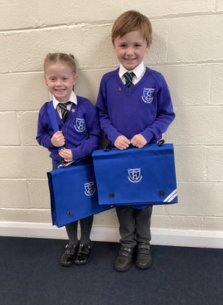
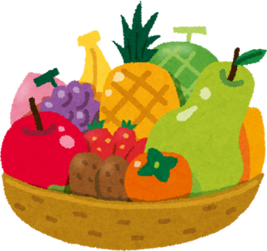

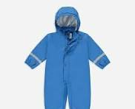

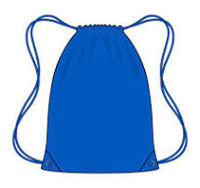
First Day - What do I need?
  Carleton Green School book bag (no pencil cases or stationery needed)
  A refillable water bottle with their name on
  A fruit or vegetable snack (if in a tub, please put name on)
  Coat
  Wellies and a puddle suit
  PE bag
  Sun hat / sun cream, if necessary (all named)
Your paragraph text

Slide 14
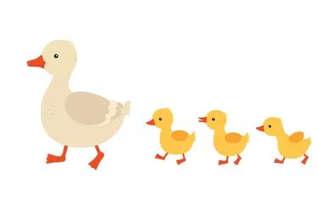
We look forward to getting to know you all.
Thank you.
Your paragraph text

